Slide 1
Introduction to .NET Framework
By Nimesh Kumar Dagur,CDAC,India

Slide 2
Topics
What is the .NET Framework?
How .NET applications work?
What is C# and how it relates to the .NET Framework
Tools available for creating .NET applications with C#

Slide 3
WHAT IS THE .NET FRAMEWORK?
The .NET Framework is a revolutionary platform created by Microsoft for developing applications.
It consists of the common language runtime (CLR) which is the execution engine that handles running applications and the .NET Framework class library, which includes classes, interfaces, and value types that support an extensive range of technologies.
With .NET framework, Microsoft has provided programmers a single platform for developing applications using different programming languages such as VB,C#,VC++.
The .NET Framework is really a cluster of several technologies:
The .NET languages: Visual Basic, C#, F#, and C++
The Common Language Runtime (CLR): This is the engine that executes all .NET programs and provides automatic services for these applications, such as security checking, memory management, and optimization.

Slide 4
WHAT IS THE .NET FRAMEWORK?
The .NET Framework class library: The class library collects thousands of pieces of prebuilt functionality that you can “snap in” to your applications.
These features are sometimes organized into technology sets, such as ADO.NET (the technology for creating database applications) and Windows Presentation Foundation (WPF, the technology for creating desktop user interfaces).

Slide 5
WHAT IS THE .NET FRAMEWORK?
ASP.NET: This is the engine that hosts the web applications you create with .NET, and supports almost any feature from the .NET Framework class library.
ASP.NET also includes a set of web-specific services, such as secure authentication and data storage.

Slide 6
WHAT IS THE .NET FRAMEWORK?
Visual Studio: To enable developers to use the features and services offered by the .NET framework Microsoft introduced a development and execution software called Visual Studio.
It provides a comprehensive and integrated environment for developing applications that use the features and services provided by .NET Framework.
It allows you to develop various types of applications, such as Console applications, Windows form applications, web applications and web services in any of the .NET languages such as vb, C#, VC++.
Visual Studio includes the complete .NET Framework, so you won’t need to download it separately.

Slide 7
Benefits of .NET Framework
Consistent Programming model
Cross platform support
Language interoperability
Automatic Management of Resources (AGC)
Ease of deployment

Slide 8
Solution (.sln)
Project1
Project2
Project3
VB
C++
C#

Slide 10




Slide 11
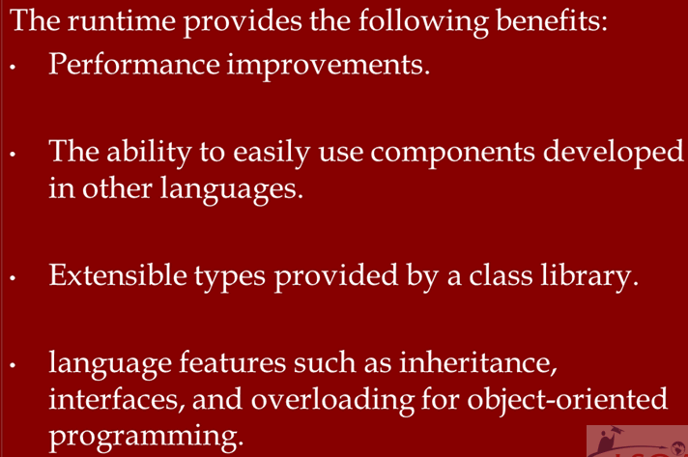

Slide 12
Parent
Class1
Parent Class2
Parent Class
Multiple Class Inheritance
Child Class1
Child Class2
Child Class
Single Class Inheritance
Multiple Interface Inheritance

Slide 13


Slide 14
.NET Framework Architecture
.NET Framework at its core consists of:
Common Language Runtime (CLR),
Base Class Library (BCL) or FCL(Framework Class Library),

Slide 15
Components of .NET Framework Architecture - Common Language Runtime (CLR)
CLR is responsible for the execution of all applications developed using the .NET library.

Slide 16
Components of .NET Framework Architecture - Base Class Library (BCL)
This is a library of functionalities which are available to all languages using the .NET Framework.
It consists of classes, interfaces of reusable types that integrates with CLR

Slide 17
Components of .NET Framework Architecture - ADO.Net
This is used to create Data Access Layer to query and manipulate data from underlying data source like SQL Server, Oracle, and DB2 etc.

Slide 18
Components of .NET Framework Architecture - LINQ
This allows you to query the data from the various data sources (like SQL databases, XML documents, Ado.Net Datasets, Various Web services and any other objects such as Collections, Generics etc.) using a SQL Query like syntax with .Net framework languages like C# and VB.

Slide 19
Components of .NET Framework Architecture - Visual Studio
The Visual Studio IDE offers a set of tools that help you to write and modify the code for your programs, and also detect and correct errors in your programs.
Using Visual Studio you can build, desktop apps, mobile apps, ASP.NET web apps, and web services

Slide 20
What’s in the .NET Framework?
The .NET Framework consists primarily of a huge library of code that you use from your client languages (such as C#) using object-oriented programming (OOP) techniques.
This library is categorized into different modules
Example:
one module contains the building blocks for Windows applications, another for network programming, and another for web development.
Some modules are divided into more specific sub modules, such as a module for building web services within the module for web development.

Slide 21
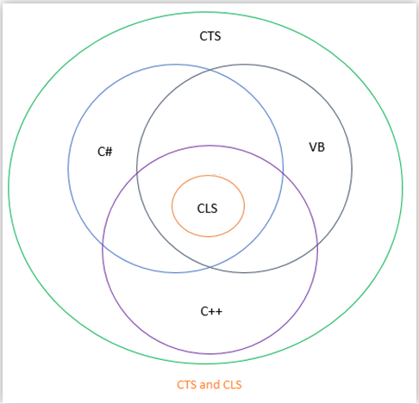
CTS & CLS
CTS and CLS are parts of .NET CLR and are responsible for type safety with in the code.
Both allow cross language communication and type safety.

Slide 22


Slide 23
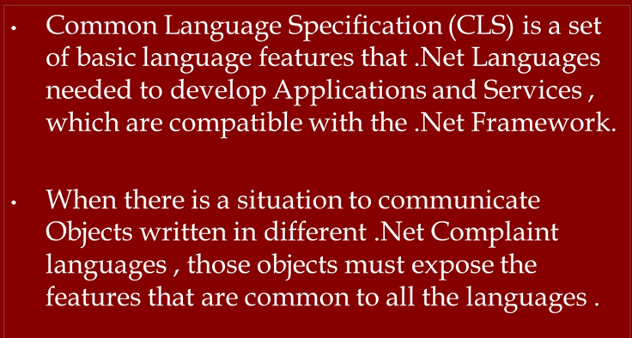

Slide 24
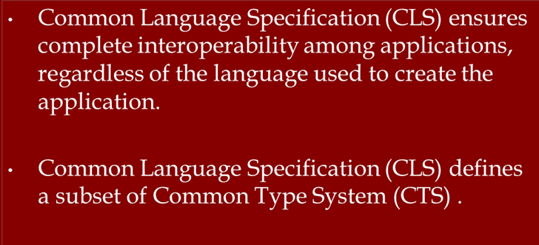

Slide 25


Slide 26
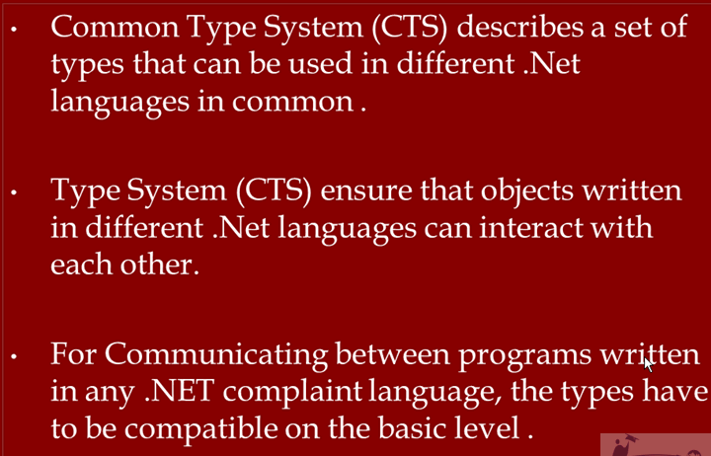

Slide 27
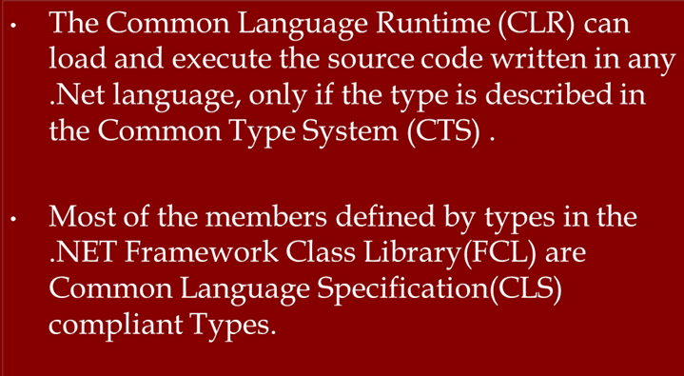

Slide 28
What’s in the .NET Framework?
Common Type System(CTS):
CTS stands for Common Type System.
It defines the rules which Common Language Runtime follows when declaring, using, and managing types.
The common type system performs the following functions:
It enables cross-language integration, type safety, and high-performance code execution.
It provides an object-oriented model for implementation of many programming languages.
It defines rules that every language must follow which runs under .NET framework. It ensures that objects written in different .NET Languages like C#, VB.NET, F# etc. can interact with each other.

Slide 29
Common Language Specification (CLS):
CLS stands for Common Language Specification and it is a subset of CTS.
It defines a set of rules and restrictions that every language must follow which runs under .NET framework.
The languages which follows these set of rules are said to be CLS Compliant. In simple words, CLS enables cross-language integration.
Example:
One rule is that you cannot use multiple inheritance within .NET Framework. As you know C++ supports multiple inheritance but; when you will try to use that C++ code within C#, it is not possible because C# doesn’t supports multiple inheritance.
One another rule is that you cannot have members with same name with case difference only i.e. you cannot have add() and Add() methods. This easily works in C# because it is case-sensitive but when you will try to use that C# code in VB.NET, it is not possible because VB.NET is not case-sensitive.

Slide 30
Writing Applications Using the .NET Framework
Writing an application using the .NET Framework means writing code (using any of the languages that support the Framework) using the .NET code library.
In this course, you use Visual Studio for your development.
VS is a powerful, integrated development environment that supports C# (as well as managed and unmanaged C++,Visual Basic, and some others).
The advantage of this environment is the ease with which .NET features can be integrated into your code.

Slide 31
Writing Applications Using the .NET Framework
The code that you create will be entirely C# but use the .NET Framework throughout, and you’ll make use of the additional tools in VS where necessary.
In order for C# code to execute, it must be converted into a language that the target operating system understands, known as native code.
This conversion is called compiling code, an act that is performed by a compiler.
Under the .NET Framework, this is a two-stage process.

Slide 32


Slide 33
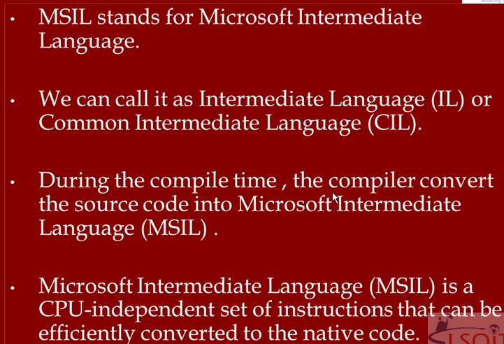

Slide 34
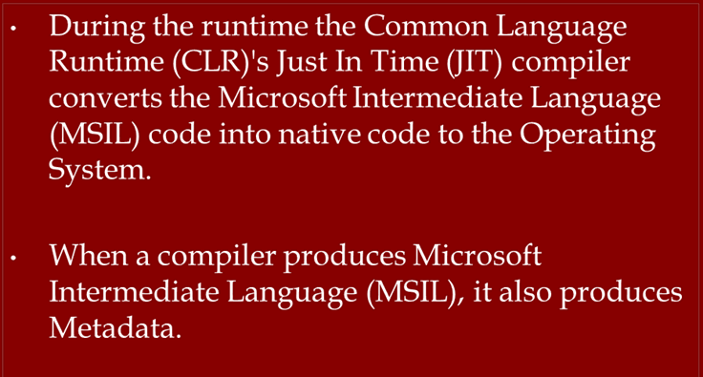

Slide 35
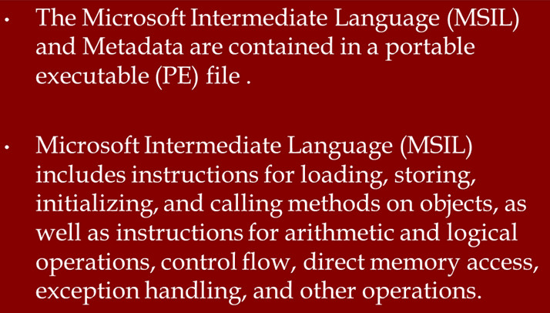

Slide 36
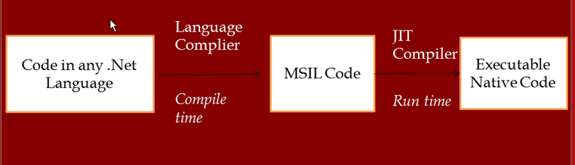

Slide 37

DYNAMIC TRANSLATION
COMPILATION AT RUN TIME

Slide 38
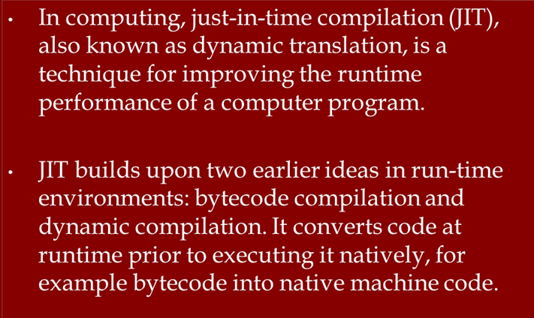

Slide 39
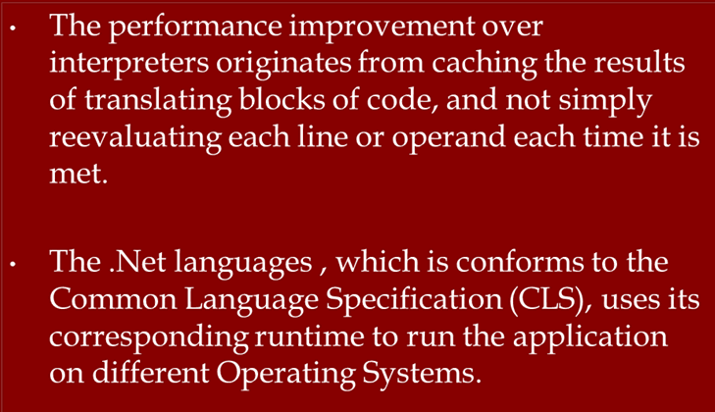

Slide 40
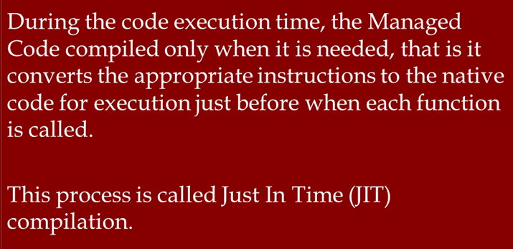

Slide 41
Common Intermediate Language (CIL) code
When you compile code that uses the .NET Framework library, you don’t immediately create operating system–specific native code. Instead, you compile your code into Common Intermediate Language (CIL) code.
CIL is also known as Microsoft Intermediate Language (MSIL)
This code isn’t specific to any operating system (OS) and isn’t specific to C#.
Other .NET languages — Visual Basic .NET, for example — also compile to this language as a first stage.
This compilation step is carried out by VS when you develop C# applications.

Slide 42
Just-in-time (JIT) compiler
just-in-time (JIT) compiler, compiles CIL into native code that is specific to the OS and machine architecture being targeted.
Only at this point can the OS execute the application.
The just-in-time part of the name reflects the fact that CIL code is compiled only when it is needed.
This compilation can happen on the fly while your application is running.

Slide 43
Assemblies
When you compile an application, the CIL code is stored in an assembly.
Assemblies include both executable application files that you can run directly from Windows without the need for any other programs (these have a .exe file extension) and libraries (which have a .dll extension) for use by other applications.

Slide 44
Assemblies
Assemblies also include meta information (Metadata) and optional resources .
Metadata is, information about the information contained in the assembly.
Optional resources - additional data used by the CIL, such as sound files and pictures.
The meta information enables assemblies to be fully self-descriptive.
This means that deploying applications is often as simple as copying the files into a directory on a remote computer.

Slide 45
Managed Code
Code written using the .NET Framework is managed when it is executed.
This means that the CLR looks after your applications by managing memory, handling security, allowing cross-language debugging, and so on.
By contrast, applications that do not run under the control of the CLR are said to be unmanaged, and certain languages such as C++ can be used to write such applications, which, for example, access low-level functions of the operating system.
However, in C# you can write only code that runs in a managed environment.
You will make use of the managed features of the CLR and allow .NET itself to handle any interaction with the operating system.

Slide 46
Garbage Collection
One of the most important features of managed code is the concept of garbage collection.
This is the .NET method of making sure that the memory used by an application is freed up completely when the application is no longer in use.
Prior to .NET this was mostly the responsibility of programmers, and a few simple errors in code could result in large blocks of memory mysteriously disappearing as a result of being allocated to the wrong place in memory.
That usually meant a progressive slowdown of your computer, followed by a system crash.

Slide 47
Garbage Collection
.NET garbage collection works by periodically inspecting the memory of your computer and removing anything from it that is no longer needed.
There is no set time frame for this; it might happen thousands of times a second, once every few seconds, or whenever, but you can rest assured that it will happen.

Slide 48

Parent Class1
Parent Class2
Parent class
Child class
Child Class1
Child Class2
Multiple Interface Inheritance

Slide 49
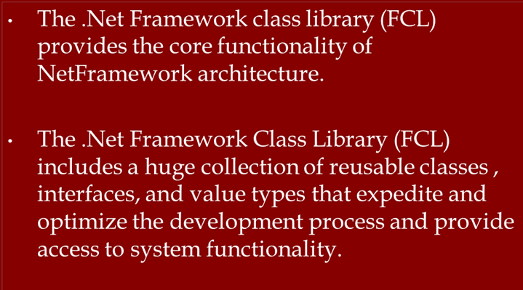

Slide 50
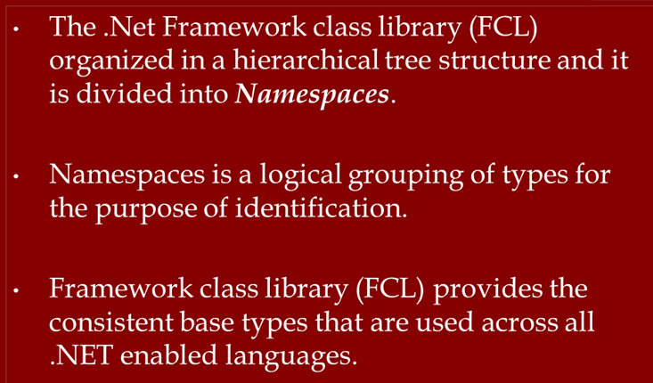

Slide 51
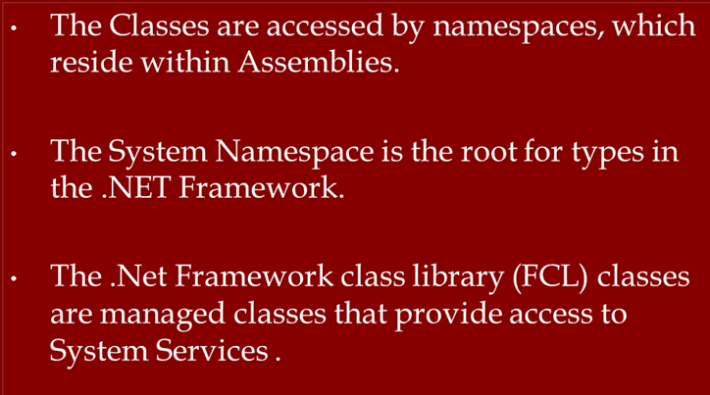

Slide 52
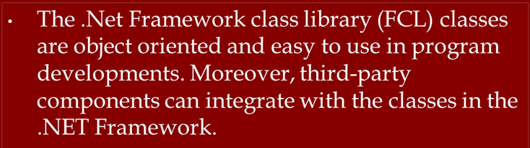

Slide 53
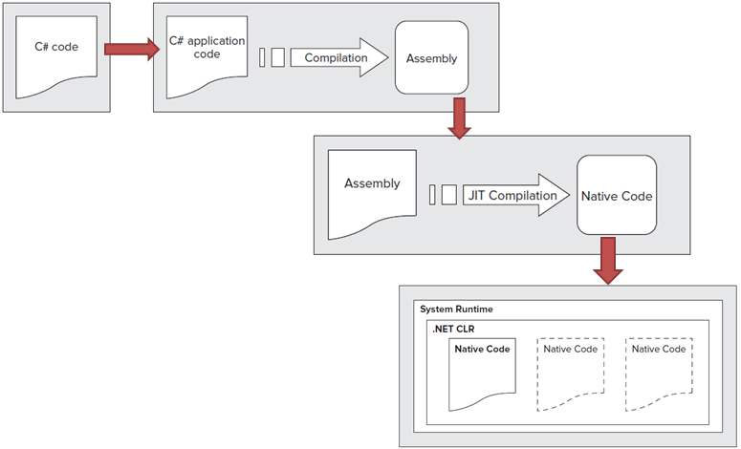

Slide 54
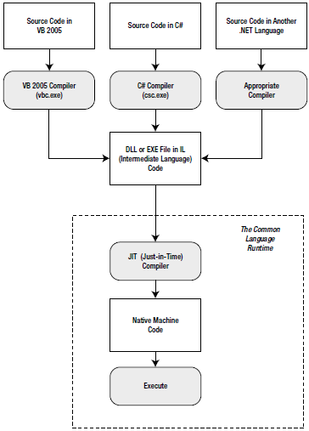
Language compilation in .NET

Slide 55
Language compilation in .NET
All the .NET languages are compiled into another lower-level language before the code is executed.
This lower level language is the Common Intermediate Language (CIL, or just IL).
The CLR, the engine of .NET, uses only IL code.
Because all .NET languages are based on IL, they all have profound similarities.
This is the reason that the VB and C# languages provide essentially the same features and performance.

